Slide 1

Housing Affordability in Metro Nashville
Luke Gaffney | DDA17 Capstone Project
Notes:
Hi my name is Luke Gaffney
This project examines how housing affordability changed in Metro Nashville between 2020 and 2023.
The reason that I was interested in completing my capstone on this topic is that I have bough and sold a house in metro Nashville during this time frame and experienced firsthand how affordability changed.

Slide 2
Purpose of This Analysis
To evaluate changes in housing affordability in Metro Nashville from 2020 to 2023 by analyzing trends in home prices, mortgage interest rates, and household income, and to identify differences in affordability outcomes across ZIP codes.
Notes:
The purpose of this analysis is to evaluate changes in housing affordability in Metro Nashville during a period of market disruption.
I focused on three key drivers of affordability: home prices, household income, and interest rates.
In addition to overall trends, I examined ZIP Code-level differences to understand whether some neighborhoods experienced greater affordability pressures than others.

Slide 3
Research Questions
How did median single-family home sale prices in Metro Nashville change between 2020 and 2023, and to what extent did median household income growth keep pace with these price changes?
How did housing inventory levels and home sales volume in Metro Nashville change between 2020 and 2023, and how did these market conditions correspond with changes in median home sale prices?
How did changes in 30-year fixed mortgage interest rates between 2020 and 2023 influence homeownership affordability for a median-income household in Metro Nashville?
Were changes in housing affordability evenly distributed across ZIP codes in Metro Nashville between 2020 and 2023, or did certain ZIP codes experience disproportionately larger shifts in affordability?
Notes:
This project is guided by four research questions.
First, I examined how median home prices changed relative to household income.
Second, I looked at housing market activity, including inventory indicators and home sales volume.
Third, I assessed how rising interest rates affected affordability for a median-income household.
Finally, I analyzed whether affordability changes were evenly distributed across ZIP codes in Metro Nashville.

Slide 4
About the data
Scope
  Location: Metro Nashville
  Period: 2020–2023
  Focus: Single-family housing affordability
Data Sources
  Metro Nashville Parcel Sales Data: Used to calculate median single-family home sale prices from observed transactions
  Redfin Market Data: Used for inventory indicators, total homes sold, and market competitiveness
  U.S. Census ACS: Used for median household income and housing context at the ZIP (ZCTA) level
  FRED (Federal Reserve Economic Data): Used for 30-year fixed mortgage interest rates
Notes:
This analysis focuses on Metro Nashville from 2020 through 2023.
I combined multiple datasets to capture different dimensions of affordability.
Parcel sales data provided transaction prices for single-family homes.
Redfin data provided housing market indicators like inventory and homes sold.
Census ACS data provided median household income at the ZIP code level.
Mortgage rate data came from FRED and reflect national 30-year fixed rates.

Slide 5
Metro Nashville Housing Market Snapshot
2020
2023
$320,000
Median Sale Price
$74,974
Median Household Income
$437,200
Median Sale Price
$90,246
Median Household Income
38,234
Total Single-Family Home Sales
3.11%
Avg 30-Yr Mortgage Rate
26,570
Total Single-Family Home Sales
6.81%
Avg 30-Yr Mortgage Rate
Sources: Metro Nashville Parcel Data, Redfin, U.S. Census ACS, FRED
Notes:
This provides a high-level comparison for Metro Nashville between 2020 and 2023.
Median home prices increased from $320,000 to over $437,000.
Median household income increased as well, but at a slower pace.
At the same time, total single-family home sales declined significantly.
Mortgage rates more than doubled, increasing borrowing costs and reducing affordability.

Slide 6
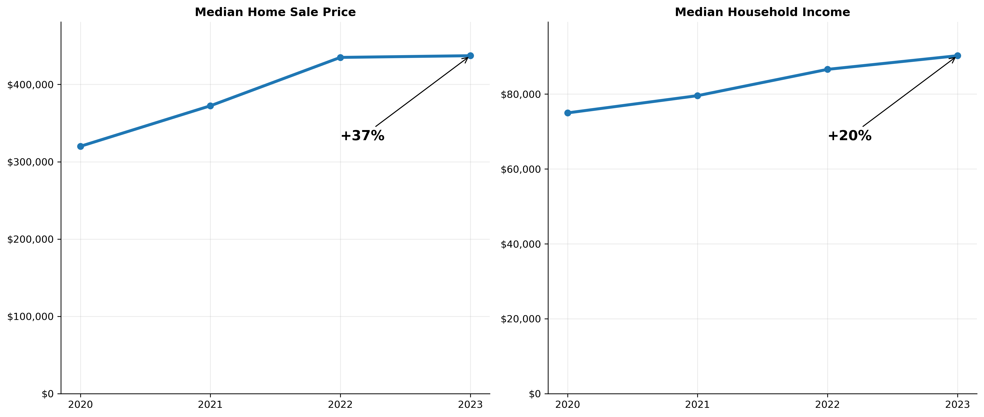
Sale Price vs Income in Metro Nashville
Median home prices increased substantially faster than household incomes between 2020 and 2023.
Sources: Metro Nashville Parcel Data, Redfin, U.S. Census ACS, FRED
Notes:
This compares trends in median home prices and median household income.
Home prices increased substantially faster than incomes over this period.
Between 2020 and 2023, prices rose by roughly 37%, while incomes only increased by about 20%.
This growing gap suggests that affordability worsened even before considering other factors.

Slide 7
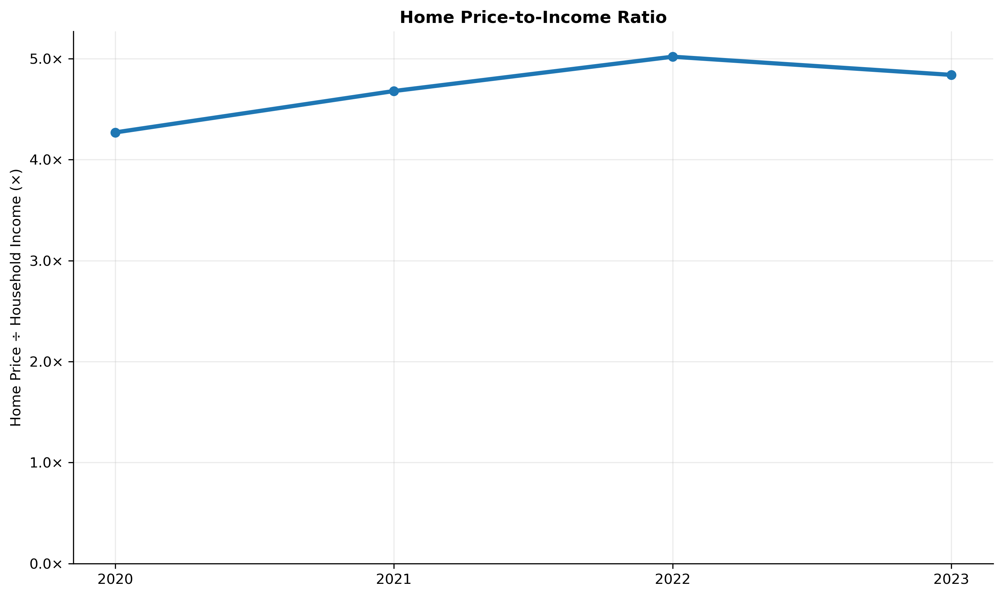
The Price-to-Income Gap in Metro Nashville
Median Home Sale Price
Price-to-Income Ratio =
Median Household Income
Between 2020 and 2022, median home prices rose faster than incomes, increasing the price-to-income ratio from 4.3 to 5. While incomes rose in 2023, affordability remained strained, with the ratio remaining elevated relative to earlier years.
Sources: Metro Nashville Parcel Data, Redfin, U.S. Census ACS, FRED
Notes:
The price-to-income ratio measures housing affordability by comparing the cost of a median home to the income of a median household and helps summarizes the relationship between home prices and income
The formula for this is (Median Home Sale Price/Median Household Income=Price-to-Income Ratio)
This is widely used by the US department of Housing and Urban Development or HUD
A higher ratio indicates reduced affordability.
Between 2020 and 2022, the ratio increased as prices outpaced income growth.
While income growth in 2023 slightly reduced the ratio, affordability pressure remained elevated compared to earlier years in the period.

Slide 8
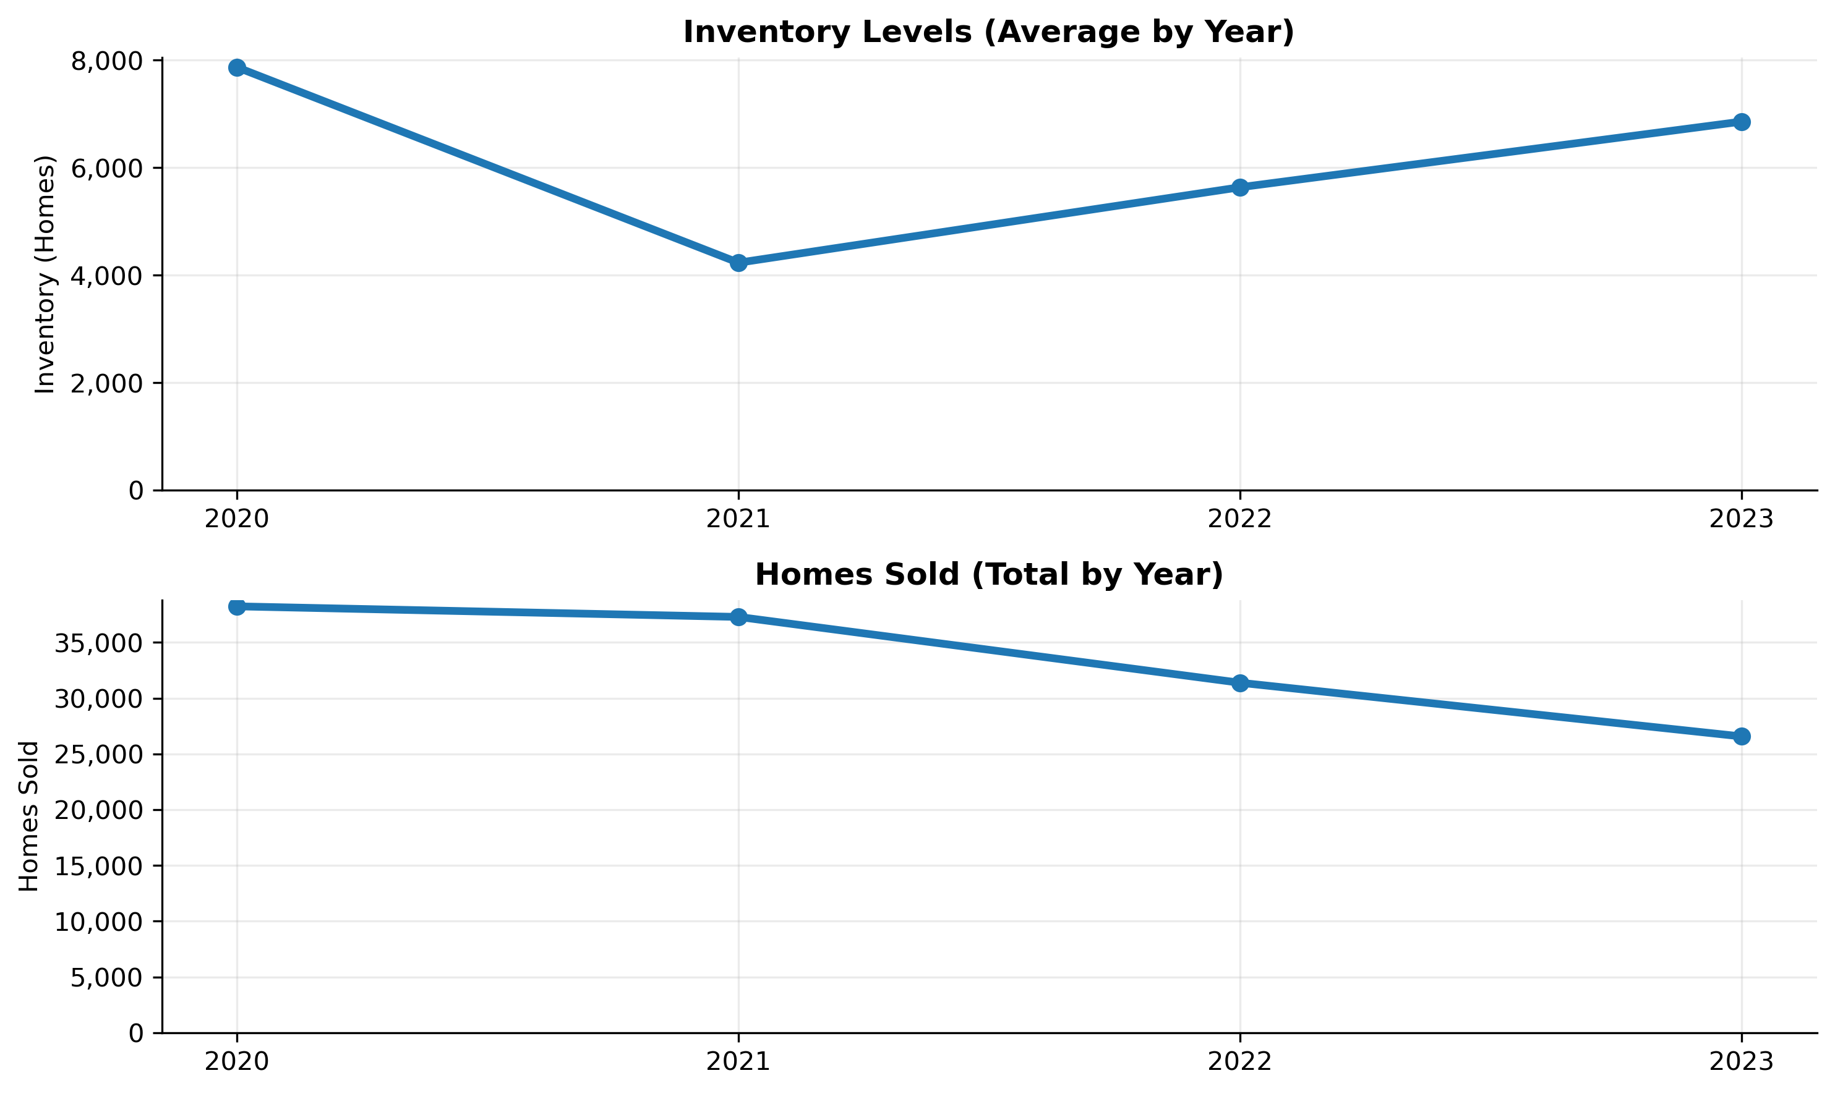
Housing Supply Trends
Housing market conditions tightened in 2021 as inventory declined and sales activity remained elevated. Even as inventory partially recovered after 2021, higher prices and rising mortgage rates reduced sales activity, contributing to continued price pressure and affordability challenges.
Sources: Metro Nashville Parcel Data, Redfin, U.S. Census ACS, FRED
Notes:
This slide shows changes in market conditions.
During this period, Metro Nashville experienced continued population growth, while housing inventory remained constrained. This imbalance between demand and available housing helps explain why prices continued to rise despite fluctuations in sales volume.
Average inventory reflects the typical number of homes available for sale at any point during the year. Rather than using a single month, I averaged monthly inventory values to capture overall supply conditions
Inventory declined in 2021, tightening market conditions. Even as inventory partially recovered in later years, home sales continued to decline.
Higher prices and rising mortgage rates reduced buyer activity, contributing to continued affordability challenges.

Slide 9
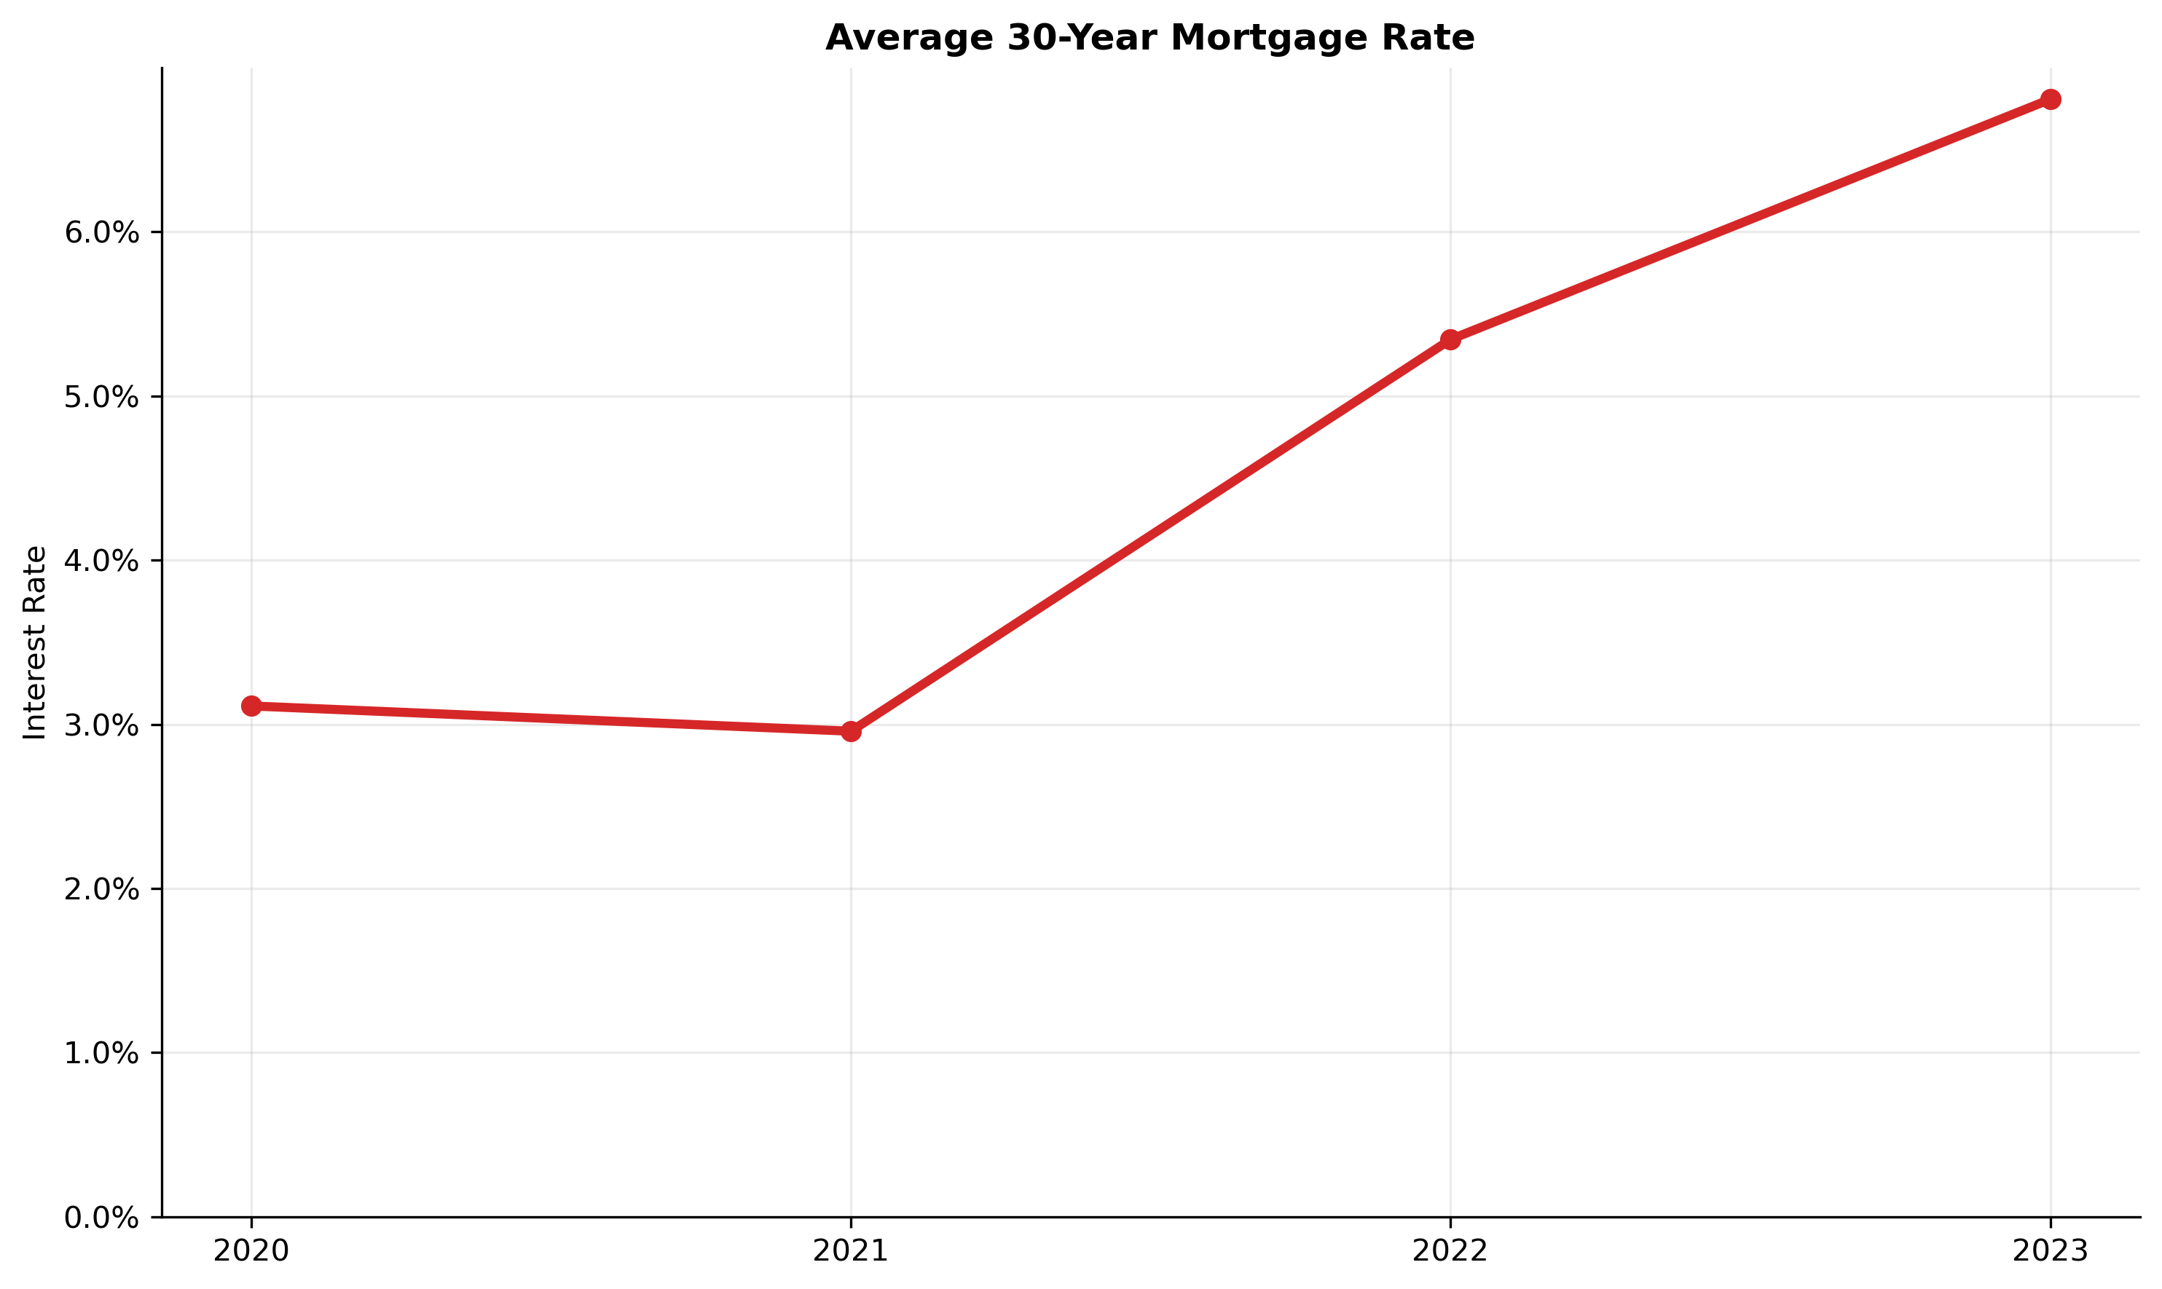
Rising Mortgage Rates Increased Borrowing Costs
Mortgage interest rates remained historically low in 2020–2021, but rose sharply beginning in 2022, increasing monthly mortgage payments and the cost of financing a home purchase.
Sources: Metro Nashville Parcel Data, Redfin, U.S. Census ACS, FRED
Notes:
Mortgage interest rates remained historically low in 2020 and 2021. Beginning in 2022, rates increased rapidly.
Due to these increases this significantly raised monthly mortgage payments.
Higher borrowing costs compounded affordability challenges created by rising home prices.

Slide 10
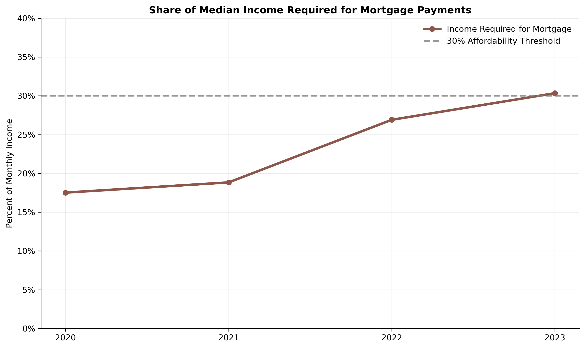
Higher Mortgage Rates Reduced Homeownership Affordability
As mortgage rates increased, the share of median household income required for mortgage payments increased. By 2023, typical housing costs exceeded the 30% affordability threshold, reducing affordability for many median-income households under standard housing cost thresholds.
Sources: Metro Nashville Parcel Data, Redfin, U.S. Census ACS, FRED
Notes:
This slide shows the share of median household income needed to comfortably afford monthly mortgage payments.
The dashed line represents the commonly used 30% affordability threshold, above which households are considered cost-burdened to the buyer.
This chart estimates the share of median household income required for monthly mortgage payments on a median-priced home. Monthly mortgage payments are calculated using median home prices and mortgage rates, then expressed as a percentage of median household income.
By 2023, housing costs exceeded this threshold for median-income households. Reducing affordability for many median-income households under standard housing cost thresholds.
If asked how I did this, I calculated what the average monthly mortgage payment would be with 20% down and the interest rate that year and used the median monthly income

Slide 11
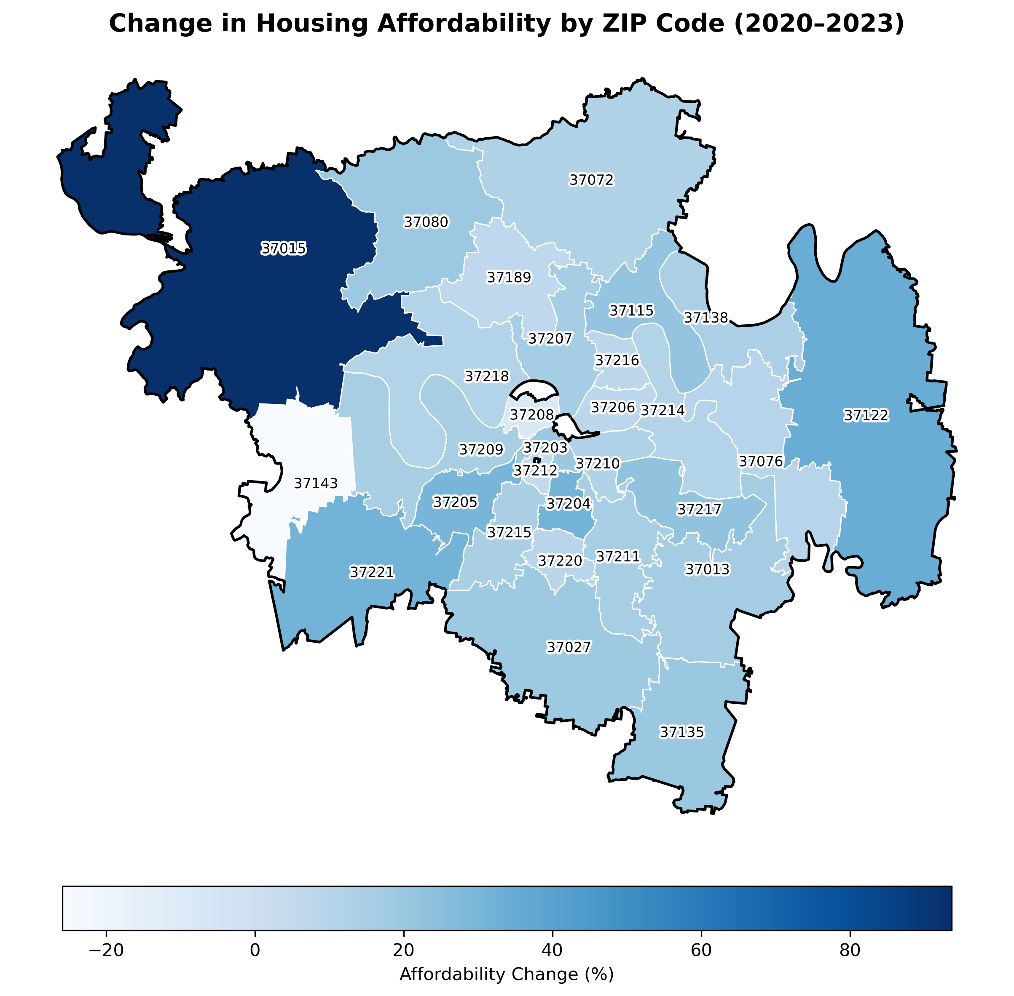
Affordability Pressures Were Uneven Across Metro Nashville
Housing affordability worsened across nearly all ZIP codes
Changes were uneven, with significant neighborhood-level variation
Two ZIP codes experienced modest improvement due to stronger income growth
Sources: Metro Nashville Parcel Data, Redfin, U.S. Census ACS, FRED
Notes:
Affordability changes were not evenly distributed across Metro Nashville.
This map shows that affordability pressures were widespread across Metro Nashville. While nearly all ZIP codes saw worsening affordability, only two experienced improvements. In those areas, income growth outpaced home price increases, leading to a decline in price-to-income ratios.
Some ZIP codes experienced much larger increases in price-to-income ratios than others.
This suggests that affordability outcomes are driven by localized income and housing market dynamics rather than uniform metro-wide trends.
This highlights the importance of examining affordability at a local level rather than relying only on metro-wide averages.

Slide 12
Key Findings
Home Prices Outpaced Income Growth
  Median home sale prices in Metro Nashville rose 37% between 2020 and 2023, while median household income increased by only 20%.
  This widening gap reduced affordability for median-income households.
Affordability Declined Despite Income Gains
  The price-to-income ratio increased from 4.3% in 2020 to a peak of 5% in 2022, remaining elevated in 2023.
  Higher home prices required households to devote a larger share of income to housing.
Rising Mortgage Rates Drove Affordability Losses
  30-year fixed mortgage rates rose sharply after 2021, exceeding 6% by 2023.
  Mortgage payments increased from 19% to over 30% of median income, surpassing standard affordability thresholds.
Housing Supply Remained Constrained
  Inventory fell in 2021 and only partially recovered by 2023.
  As affordability worsened, home sales declined even as prices remained high.
Affordability Impacts Varied by ZIP Code
  Changes in affordability were not evenly distributed across Metro Nashville.
  Several ZIP codes experienced substantially larger increases in affordability pressure than the metro average.
Notes:
Home prices increased faster than incomes, widening the affordability gap.
Rising mortgage rates significantly increased borrowing costs.
Housing market conditions tightened early in the period and remained challenging.
Affordability pressures were uneven across ZIP codes.
Together, these factors contributed to a substantial decline in homeownership affordability.

Slide 13
Limitations & Next Steps
Metro Nashville ZIP code boundaries vary across data sources, creating challenges in defining a consistent study area.
ZIP code level income data limited the analysis to 2020–2023.
Future research could extend this work over a longer time horizon and explore alternative geographic units to deepen insight into long-term affordability trends.
Notes:
There are several limitations to this analysis.
ZIP code boundaries and definitions vary across data sources.
Future work could examine longer time horizons
Additional factors like rents or demographic changes could also be explored.

Slide 14
Conclusion
Between 2020 and 2023, rising home prices, higher mortgage rates, and constrained housing supply combined to significantly reduce homeownership affordability for median-income households in Metro Nashville, with uneven impacts across ZIP codes
Together, these findings highlight how multiple market forces not prices alone, shaped worsening housing affordability in Metro Nashville.
Notes:
Between 2020 and 2023, rising home prices, higher mortgage rates, and constrained market conditions significantly reduced housing affordability in Metro Nashville.
While incomes increased, they did not keep pace with housing costs.
Affordability pressures were not evenly distributed across neighborhoods.
Overall, this analysis shows how multiple market forces combined to worsen housing affordability in Metro Nashville during this period.

Slide 15
Q&A
Thank you!

